Slide 1
USA USED CARS SALES REPORT
Sales Forecast Dashboard

Slide 2
Overview
This is a data visualization project based on a USA used cars sales dataset from Kaggle.
The aim of the project is to provide insights to individuals or companies looking to get into automobile sales business in the United States. The results will help in making data driven decisions on matters pertaining the automobile sales industry.
For this reason there was need to come up with KPI’s which can provide insights on the issues arising in the automobile industry.
The results are displayed in a dynamic tableau dashboard that updates automatically when the data source is updated.
The dataset contained 16 fields with 558838 records in a csv format.

Slide 3
Skills Demonstrated in the Project
Data cleaning
Data transformation
Data analysis
Data visualization
Drawing insights from data
Critical thinking
Microsoft Power Point presentation skills

Slide 4
Steps Carried Out In The Project
Data Cleaning and Transformation in EXCEL.
Data Visualization in TABLEAU PUBLIC.
Presentation in POWER POINT.

Slide 5
Data Cleaning and Transformation in Excel
The dataset contained so many blanks, nulls and inconsistencies which required thorough cleaning.
The first step was removing the duplicate records using the duplicate function and what remained was distinct records.
Filters were added next to eliminate blanks and nulls to ensure the data was consistent.
I capitalized the first letter of the column tittles and made them bold to make them more clear.
Then, I modified some column names to simple names that are easy to understand.
Finally, I changed the date format which was in date-time format to a simple date in the form YYYY-MM-DD.
The clean dataset contained 440394 records out of the initial 558838 records.

Slide 6
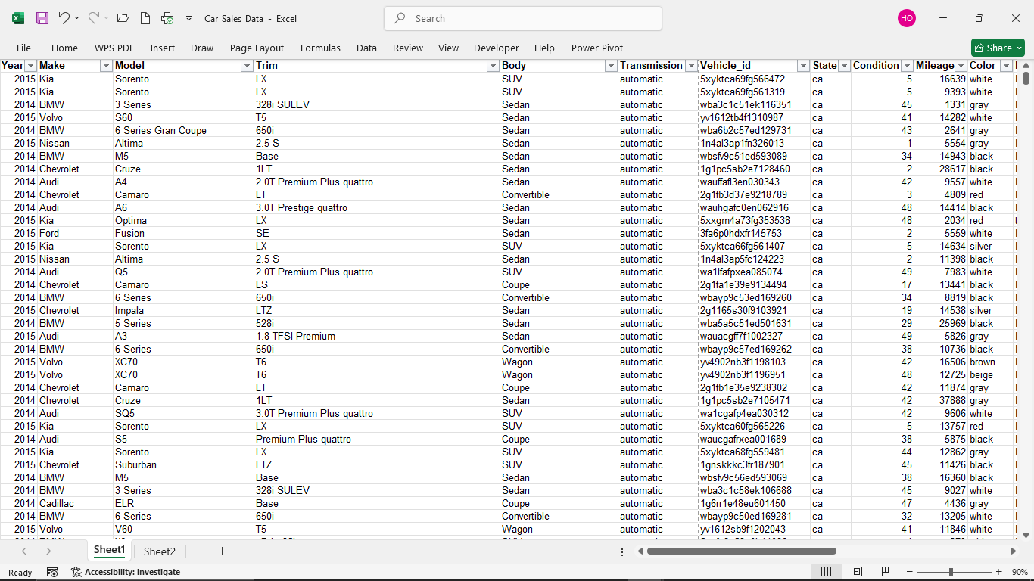
Clean Dataset

Slide 7
Key Performance Indicators (KPI’s)
KPI’s for an Overview of sales performance.
1. Total Sales Volume: Measures the total number of vehicles sold within a specific period (e.g., monthly, quarterly, annually). This KPI helps in understanding overall market demand and consumer interest.
2. Average Selling Price (ASP): Calculates the average price at which vehicles are sold. This KPI provides insights into pricing strategies and consumer spending power.
3. Sales by Condition of Vehicles: Tracks the proportion of used vehicles sold. This KPI helps in identifying consumer preferences and shifts in demand in the used car market.
4. Sales by Geography (State): Analyzes the number of vehicles sold in different states. This KPI helps identify regional demand trends and tailor marketing strategies accordingly.

Slide 8
Key Performance Indicators (KPI’s)
KPI’s for In-Depth Insights of sales performance.
1.Age of vehicle: Measures the difference in years between the date of manufacture and the date of sale. This KPI helps in identifying depreciation rate of various vehicle brands and the resale value of various used vehicles over a given period of time.
2. Price to Market Ratio: Compares the selling price of a vehicle to its Market-Minded Residual (MMR) value or simply the market price. This KPI assesses whether vehicles are being sold above or below market value, helping to refine pricing strategies.
3. Sales by Make and Model: Tracks the number of vehicles sold by each manufacturer and specific model. This KPI provides insights into consumer preferences for certain brands or models, influencing inventory and marketing decisions.
4. Mileage Impact on Selling Price: Analyzes the correlation between vehicle mileage and its selling price. This KPI helps in understanding how mileage affects depreciation and consumer buying decisions.
5. Customer Segment Analysis by Vehicle Attributes: Examines sales data by various vehicle attributes (e.g., color, trim, body style, interior). This KPI helps identify which features are most appealing to consumers, allowing for targeted marketing and inventory stocking strategies.

Slide 9
Data Visualization in Tableau
I imported the dataset using the tableau data import wizard.
Having cleaned the data, I started on the KPI’s .
In order to achieve accurate results, I had to employ the use of various formulas and functions which have described in detail in the slides below.
I used various charts depending on the KPI which best displayed the results in a detailed yet easy to draw insights from manner.
On top of that, I used various styling and formatting techniques to ensure a visually appealing dashboard.
Below are the outcomes of the KPI’s one by one.

Slide 10
Total Sales Volume- Techniques used
Used the SUM function to calculate The Total Sales.
AVERAGE function to calculate the Average Selling Price.
COUNT function to calculate total Number Of Cars Sold.
CASE STATEMENTS together with DATEDIFF function to calculate the MTD and YTD sales.
Added some Formatting and Styling to make it more presentable.

Slide 11





Total Sales Volume – Outcome.
Month To Date Total Cars Sold.
Year To Date Total Sales.

Slide 12
Sales By Car Condition - Techniques used
First of all, I used the CASE STATEMENT to categorize the car condition into 3 groups namely: Good, Average and Poor conditions according to known car condition standards. The calculation was drawn from the car condition column which was in number format in the dataset.
Then, I created a pie chart and converted it into a doughnut chart since there is no pre-made doughnut chart in tableau.
Finally, I added some color formatting and text styling to make the chart visually appealing.
The outcome was as shown below.

Slide 13
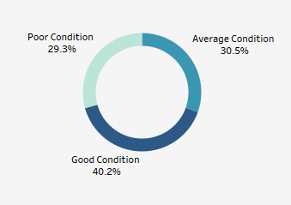
Sales By Car Condition - Outcome
Good condition cars contributed to the most sales as poor condition cars had the least sales as below.

Slide 14
Sales By Location - Techniques used
Using the latitudes and longitudes generated by Tableau, I plotted a map of the United States showing the various locations on the dataset.
Then converted the map into a field map and added a gradient color with corresponding amount of sales to show distinction.
Finally, added a medium dark background to the map for better visibility.
The outcome is shown below.

Slide 15
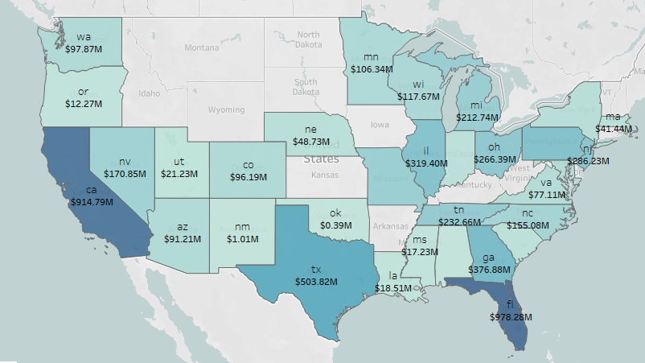
Sales By Location - Outcome
The sales distribution was as follows(More detailed when viewed in the Tableau software)
California State has the highest Sales of 917.79M while Alabama has the least sales of 0.24M.
This means that there is a high demand for used vehicles in California, Texas and Florida.

Slide 16
Price to Market Ratio - Techniques used
Used an IF STATEMENT to form categories of sales made ABOVE MARKET PRICE, AT THE MARKET PRICE and BELOW MARKET PRICE.
Then created a doughnut chart to represent the portion of sales shared by the three categories.
Finally, added some color formatting and text styling to make the chart visually appealing.
The outcome was as shown below.

Slide 17
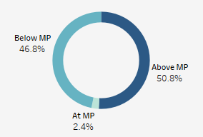
Price to Market Ratio - Outcome
This is the ratio of Selling Price to the Market Price of a particular vehicle.
50.8% of vehicles were sold above Market Price, 2.4% at the Market Price and the remaining 46.8% were sold below the Market Price.
This means that nearly half of the vehicles were sold at some loss which in turn reduces the profit margin.

Slide 18
Sales By Model-Techniques used
Used the COMBINED FIELD function to combine the ‘Make’ and ‘Model’ fields to form one complete vehicle name.
Then, represented the sales using a bar chart and added a color gradient to show hierarchy of the amount of sales for the different vehicles.
Also, created a parameter that can be used to display Top N Sales by model, where N is a number between 1 and 20.
Added some text to show the average sales for each Model.
The outcome was as shown below.

Slide 19
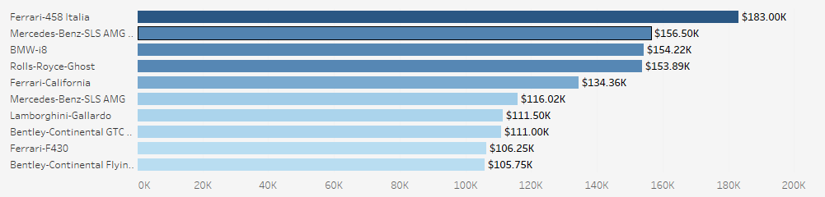
Sales By Model - Outcome
Generally, there was a high demand for performance and luxury cars compared to the other variants of vehicles sold as per the average sales analysis.
The ‘Ferrari-458 Italia’ had the highest average sales of $183K from one unit sold.
This means performance was the most sought after element in cars in the USA between 2014 and 2015.
Below are the top 10 Models with the highest average sales.

Slide 20
Sales By Make - Techniques used
Created a simple bar graph to represent the average sales by make.
Then added some text to show the average sales for each make
Also, created a parameter that can be used to display Top N Sales by make, where N is a number between 1 and 20.
Finally did some color styling to make the chart visually appealing.
The outcome was as shown below.

Slide 21
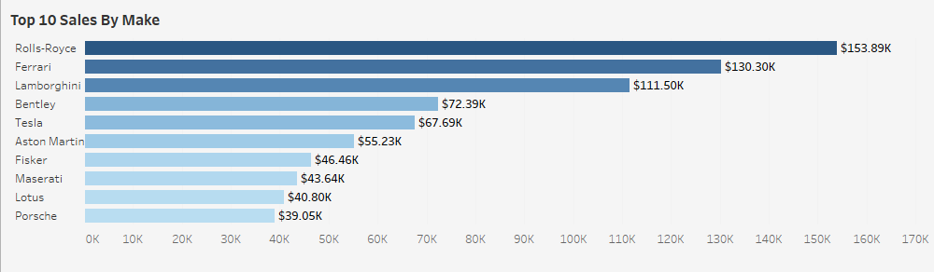
Sales By Make - Outcome
The Luxury and performance brands were the most in demand between 2014 and 2015.
Rolls-Royce had the highest average sales of $153.89K.
Below are the top 10 sales by Make.

Slide 22
YTD Sales Trend - Techniques used
This is the Year - To - Date (Current Year), in this case 2015.
Created a line chart and duplicated it.
Converted the duplicate chart into an area chart and combined the two into one axis.
Added color and text to make the chart well detailed.
Finally included an Average line to separate sales ABOVE AVERAGE and sales BELOW AVERAGE.
The outcome was as shown below.

Slide 23
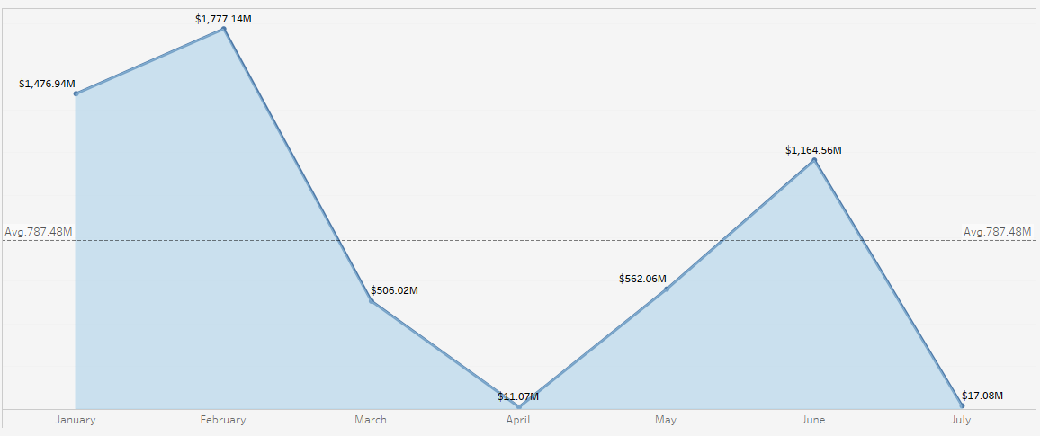
YTD Sales Trend - Outcome
This the Year-To-Date(current year) sales trend that updates automatically when records for a new year is added.
The trend(2015) shows the sales were higher during the first quarter with February having the highest sales volume of $1.47B.
The sales were generally low during the second quarter with April having the least sales volume of $11.07M.

Slide 24
CUSTOMER SEGMENT ANALYSIS
Refers to the sales by vehicle attributes such as:
Interior
Color
Trim
Body style

Slide 25
Most preferred interiors colors - Techniques used
Used a simple bubble chart to demonstrate the order of preferences of the interior colors.
Grouped some of the colors with less number of customers into one group called ‘Others’.
Added color and text to make the chart visually appealing and to add a sense of detail to it.
The outcome was as shown below.

Slide 26
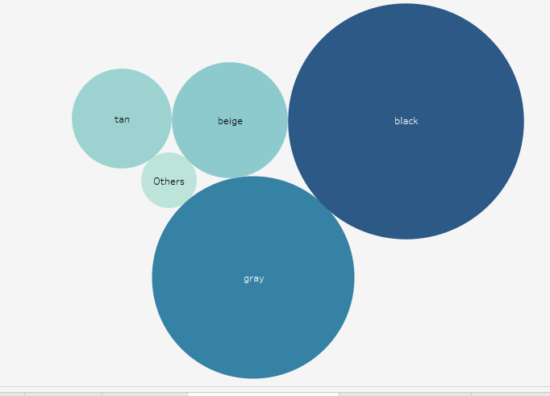
Most preferred interiors colors - Outcome
The sizes shows the order of preference by customers.

Slide 27
Most Preferred cars colors - Techniques used
Created a simple text chart to demonstrate the order of preference of the various car colors.
Grouped some of the colors with less number of customers into one group called ‘Others’.
Added color and text to make the chart visually appealing and to add a sense of detail to it.
The outcome was as shown below.

Slide 28
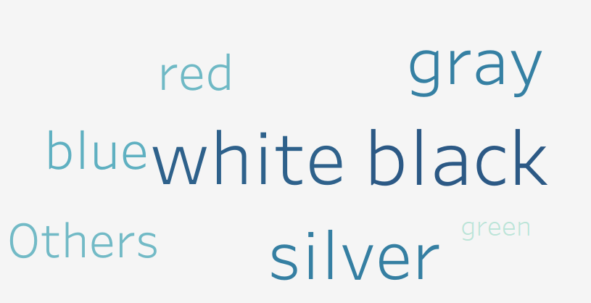
Most Preferred cars colors - Outcome
The sizes shows the order of preference by customers.

Slide 29
Relationship Between Sales and Mileage - Techniques used
Created a table to show the car name and the corresponding mileage as well as the age.
The table is capable of being filtered in terms of either car name, mileage or age.
This can easily show the relationship between the three aspects for each vehicle in the dataset.

Slide 30
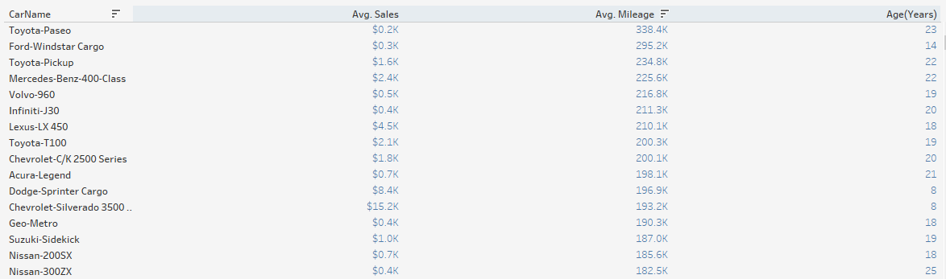
Relationship Between Sales and Mileage - Outcome
Even though there was no well defined proportionality between sales and the mileage, its safe to say ‘technically’ that the lower the mileage the higher selling price and vice versa.
I say so because, when other factors such as brand, interior and body type are included, the sales volume no longer obeys the above principle.
The following table (more detailed and interactive in Tableau software) shows the relationship between sales and mileage for different vehicles.

Slide 31
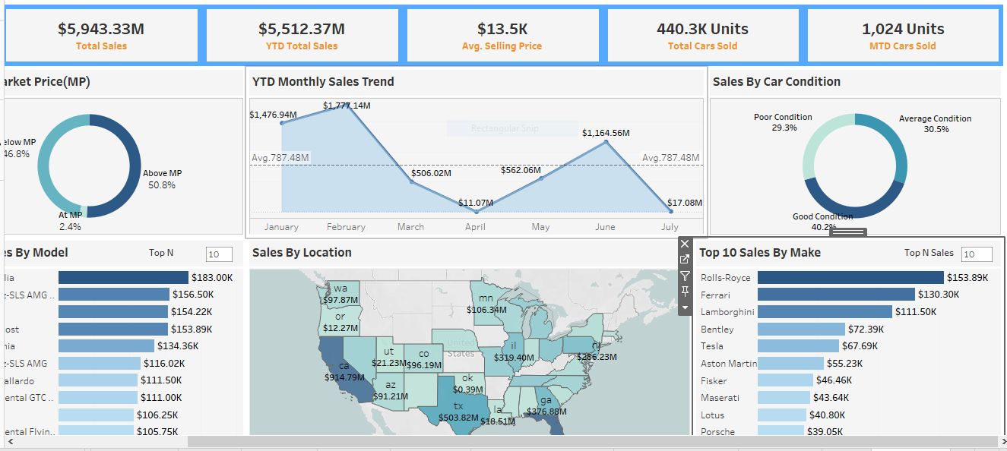
Dashboard Overview

Slide 32
Recommendations
In my capacity as a Mechanical Engineer with knowledge in motor vehicle sales, I would recommend the following considerations to those looking to venture into used vehicle sales in the United States:
It is important to stock good quality vehicles in terms of body condition, engine/battery life, etc. The bottom line is to stock ‘buy and drive’ units or units that require very little repairs after purchase.
Sales campaigns and promotions should be concentrated in California, Texas and FI states since there is a very high demand for used vehicles in those areas.
Most vehicles should be priced and sold above market price to maximize on profit.
When stocking, performance, luxury and comfort oriented brands/models should be given priority since there is a high demand for those elements.
According to Year To Date sales trend, it is advisable to stock more vehicles in the first and last quarter of the year due to high demand during the period and minimize the number of stocked cars in the second quarter of the year since there is a general low demand for cars during this period.
Though customers taste may vary from time to time, generally dark, grey and beige interiors remain the most in demand interior colors. For the exterior color of the car, silver, white and black colors are given top priority among customers.

